Slide 1
Week#02
Data Structures
CS2001
Email: rafia.shaikh@nu.edu.pk

Slide 2
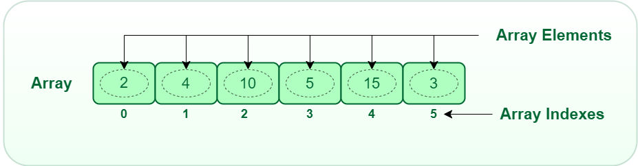
Array
Contiguous area of memory consisting of equal-size elements indexed by contiguous integers.

Slide 3
What’s Special About Arrays?
Random access memory.
Constant time access (O(1)) to any particular element in an array.
Constant time to access read and write
memory address = ArrayName+index*sizeof(datatype)

Slide 4
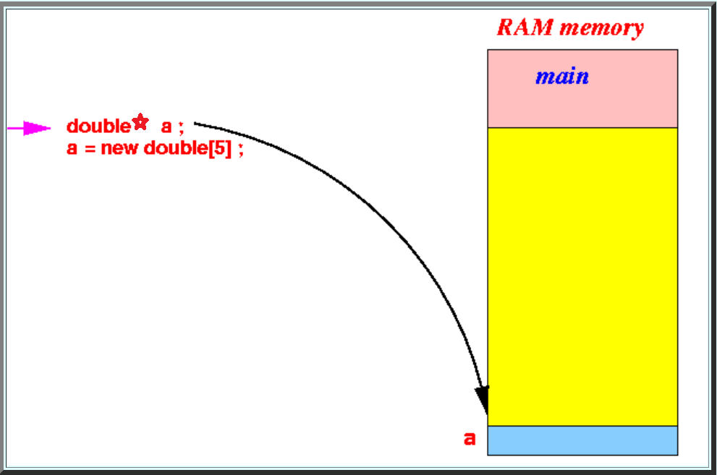

Slide 5
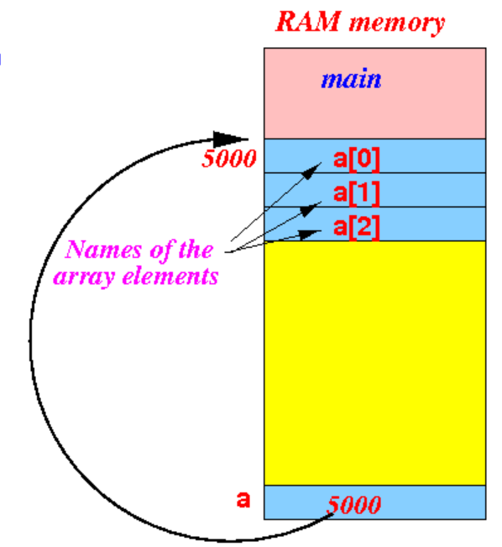

Slide 6
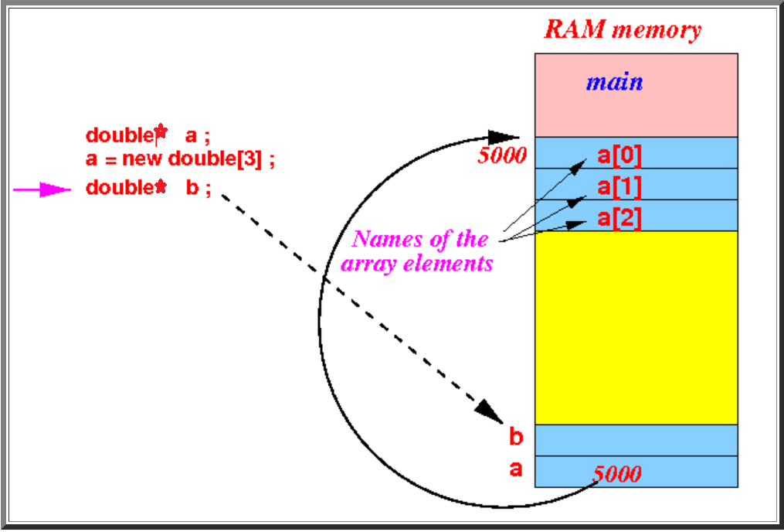

Slide 7
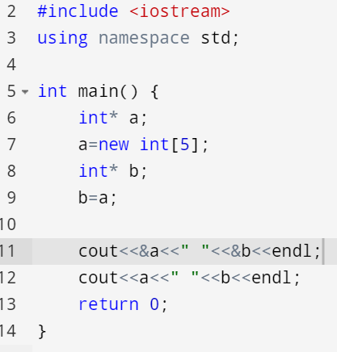
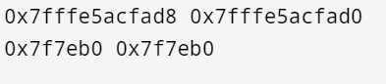

Slide 8
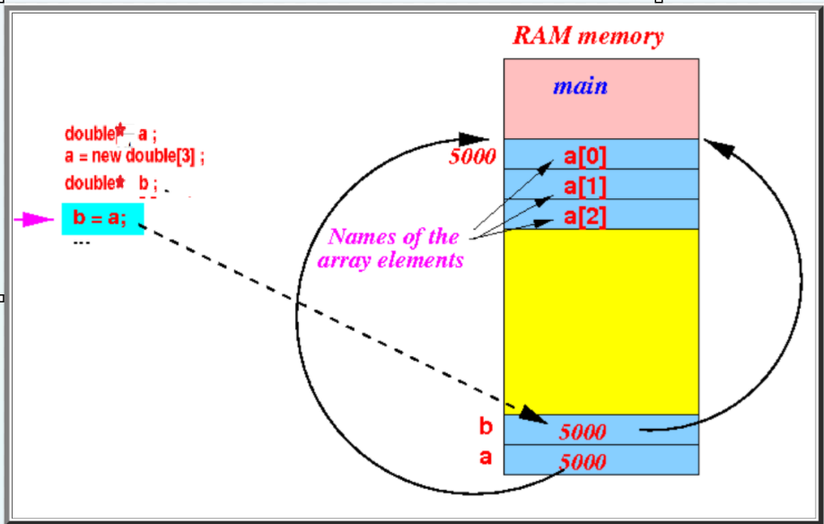

Slide 9
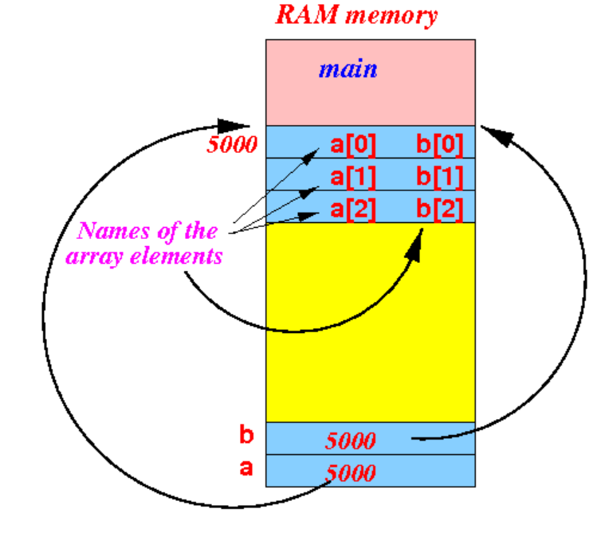

Slide 10
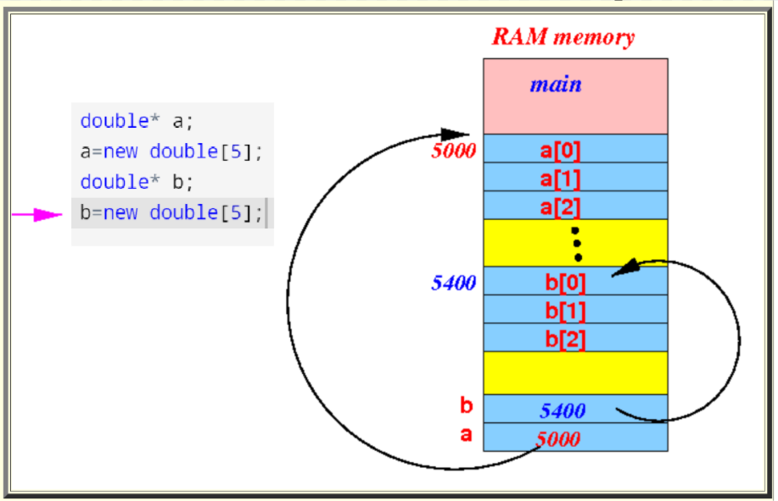
Creating two arrays using pointers

Slide 11
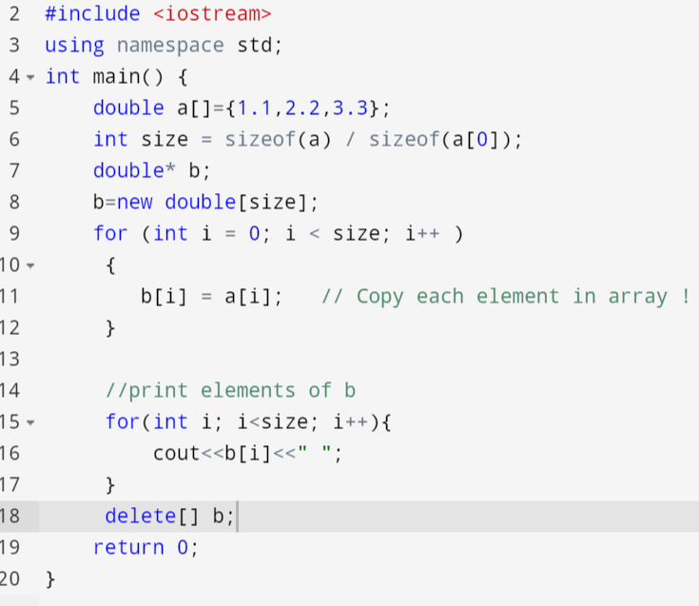
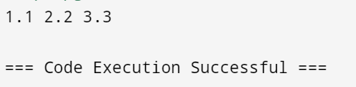
Copying the elements of array

Slide 12
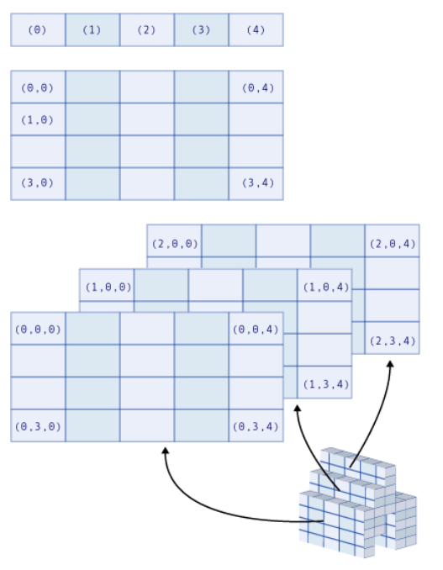
Multidimensional Array

Slide 13
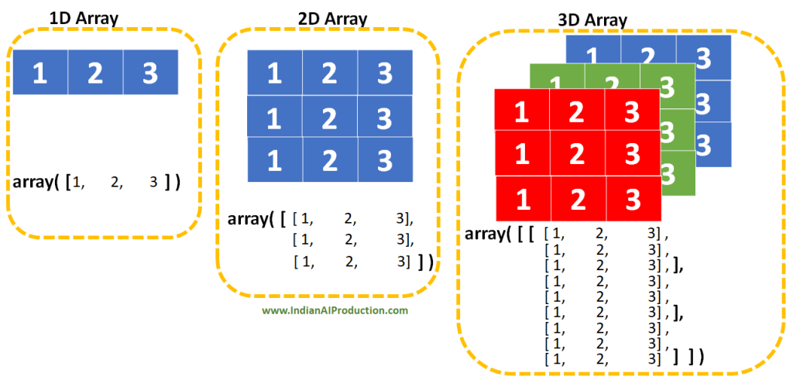
Multidimensional Array

Slide 14
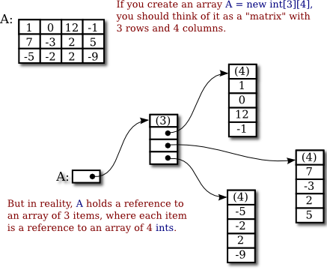
Multidimensional Array

Slide 15
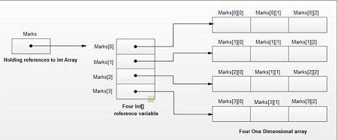
Multidimensional Array

Slide 16
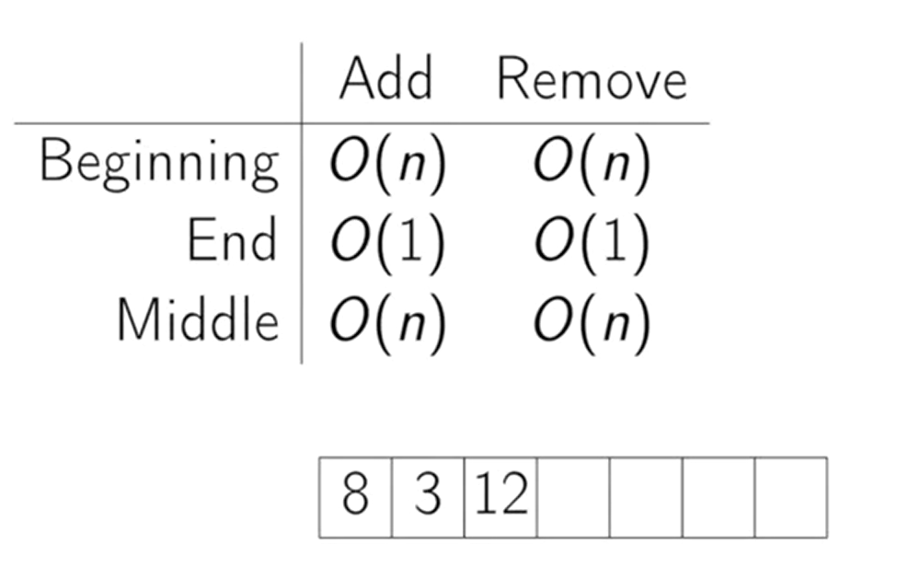
Times for common operations

Slide 17
Summary
Array: contiguous area of memory consisting of equal-size elements indexed by contiguous integers.
Constant-time access to any element.
Constant-time to add/remove at the end.
Linear time to add/remove at an arbitrary location.

Slide 18
Please get the concepts using visuals
https://visualgo.net/en/array

Slide 19
Linked List
An array is a very useful data structure provided in programming languages. However, it has at least two limitations:
(1) its size has to be known at compilation time and
(2) the data in the array are separated in computer memory by the same distance, which means that inserting an item inside the array requires shifting other data in this array.
This limitation can be overcome by using linked structures.

Slide 20
Linked List
A linked structure is a collection of nodes storing data and links to other nodes.
The most flexible implementation of linked list is by using pointers.

Slide 21
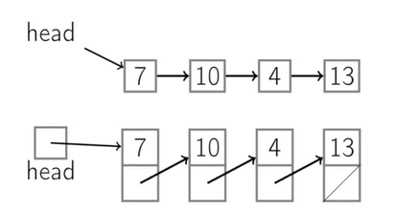
Linked List
Node contains:
Keys/Data/Content
next pointer

Slide 22
Observation
For fixed-size collections with known max limit of number of items that will ever be needed, i.e., the max size of M, then array is already a reasonably good data structure for List ADT implementation.
For variable-size collections with unknown size M and where dynamic operations such as insert/remove are common, a simple array is actually a poor choice of data structure.

Slide 23
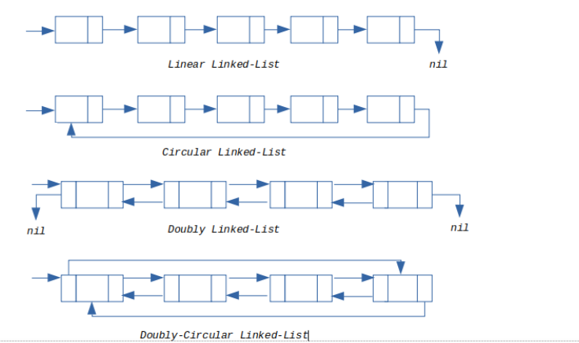
Types of Linked List
Single/Linear Linked List:
Doubly Linked List:
Circular List:
Doubly Circular List:

Slide 24
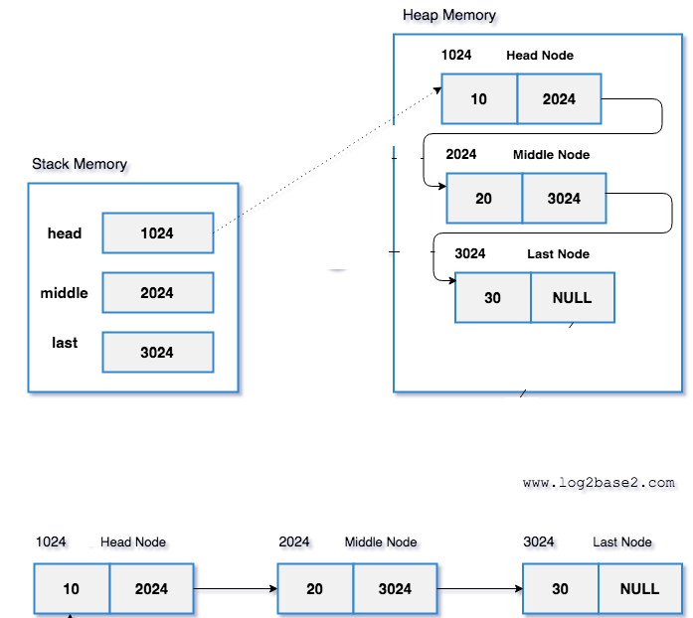
Singly Linked List
The linked list is a linear data structure where each node has two parts.
1. Data
2. Reference to the next node
Data - it can be any data type. int,char,float,double etc.
Reference Part - It will hold the address of the next node. So, it is a type pointer.

Slide 25
Operations on linked list
Add to front
return front item
remove front item
add to back
return back item
remove back item
is key in list?
remove key front list
empty list?
adds key before node
adds key after node
PushFront(Key)
Key TopFront()
PopFront()
PushBack(Key)
Key TopBack()
PopBack()
Boolean Find(Key)
Erase(Key)
Boolean Empty()
AddBefore(Node, Key)
AddAfter(Node, Key)

Slide 26
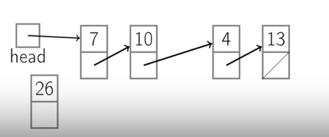
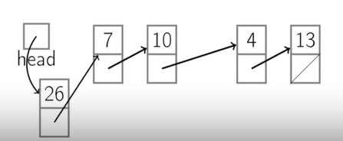
Singly-linked list - Add to front operation

Slide 27
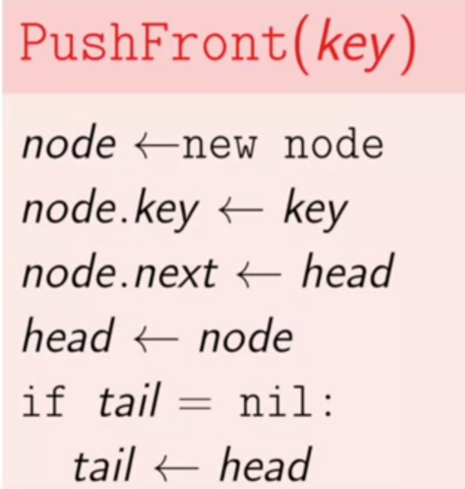
Singly-linked List
Add a new node to front operation
Time complexity O(1)

Slide 28
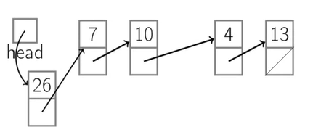
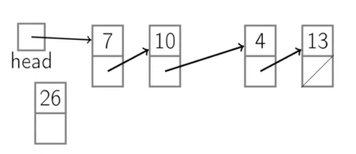
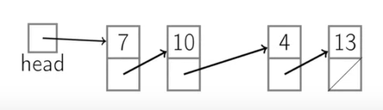
Singly-linked list; Return front item operation
Delete/remove first node
Time complexity O(1)

Slide 29
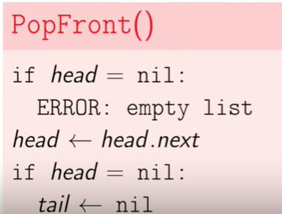
Singly-linked list; Return front item operation
Delete/remove first node
Time complexity O(1)

Slide 30
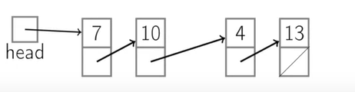
Add new node to tail
add to back
(no tail pointer)
Time complexity O(n)

Slide 31
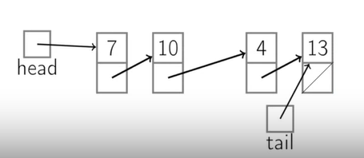
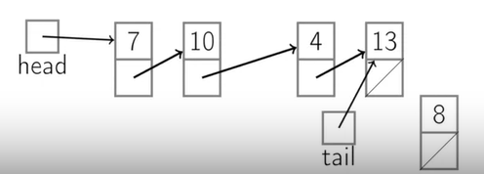
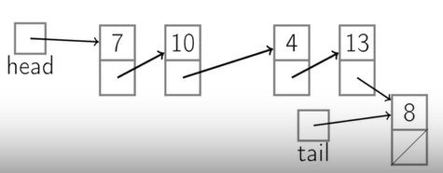
add to back operations
Time complexity O(1)
(with tail pointer)

Slide 32
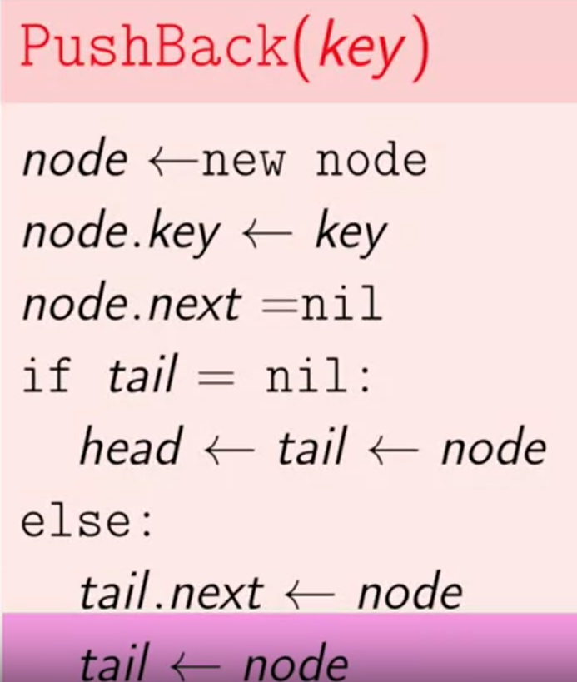

Slide 33
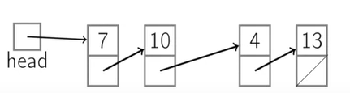
PopBack()
operations
return back item/PopBack()
Time complexity O(n)
(no tail pointer)

Slide 34
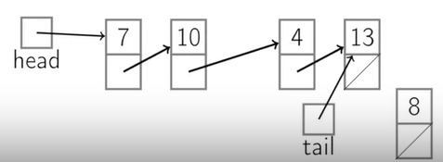
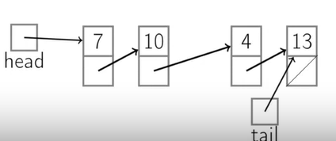
PopBack
operations
return back item /PopBack()
Time Complexity O(n)
(with tail pointer)

Slide 35
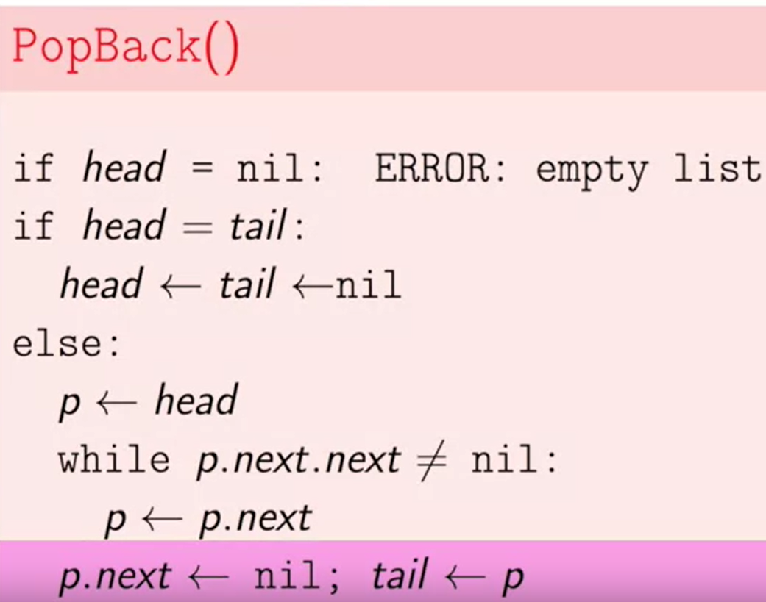

Slide 36
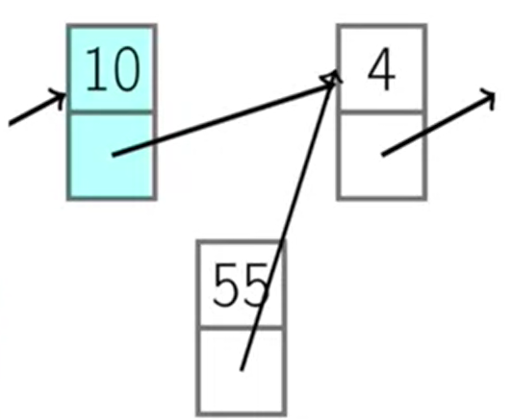
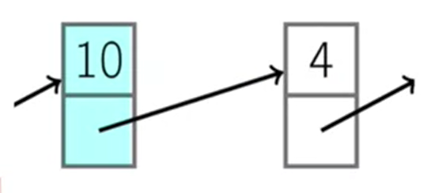
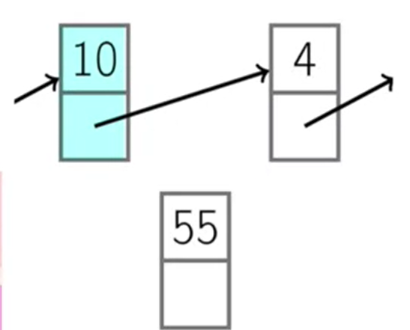
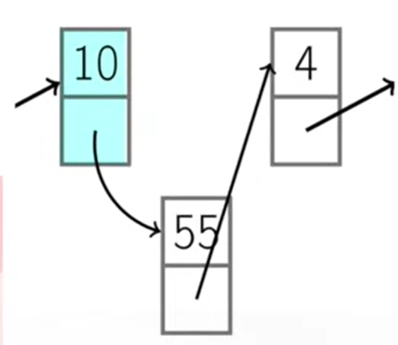
Operation; Add new node after a node
new node

Slide 37
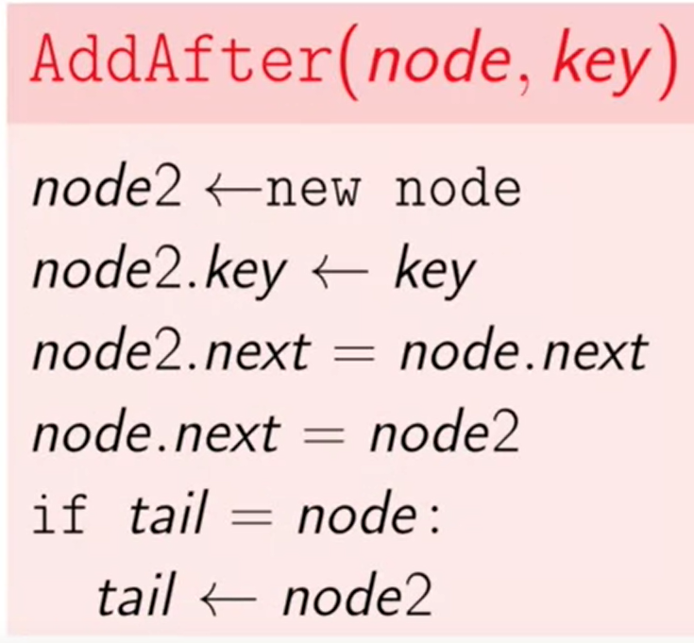

Slide 38
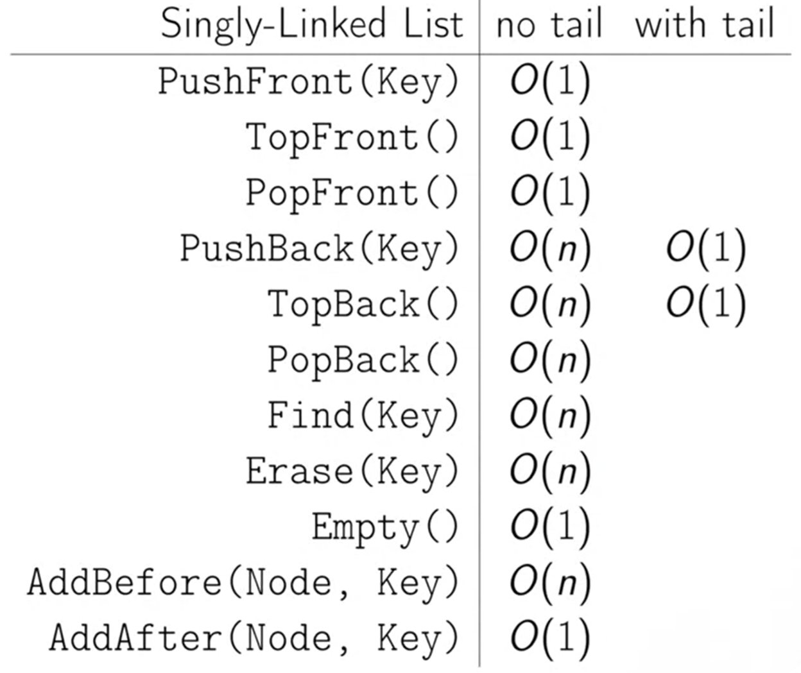

Slide 39
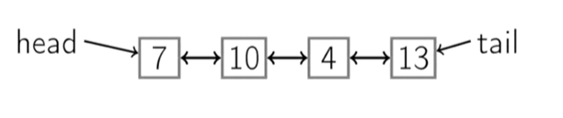
Doubly-Linked List
There is a way to make popping the back and adding before cheap. Our problem was that although we had a way to get from a previous element to the next element, we had no way to get back. And what a doubly-linked list says is, well, let's go ahead and add a way to get back. So we'll have two pointers, forward and back pointers.

Slide 40
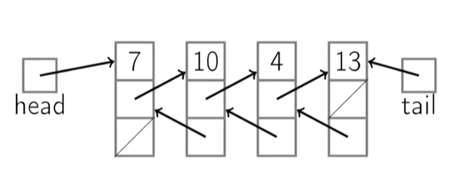
Doubly-Linked List
Node contains:
key
next pointer
previous pointer

Slide 41
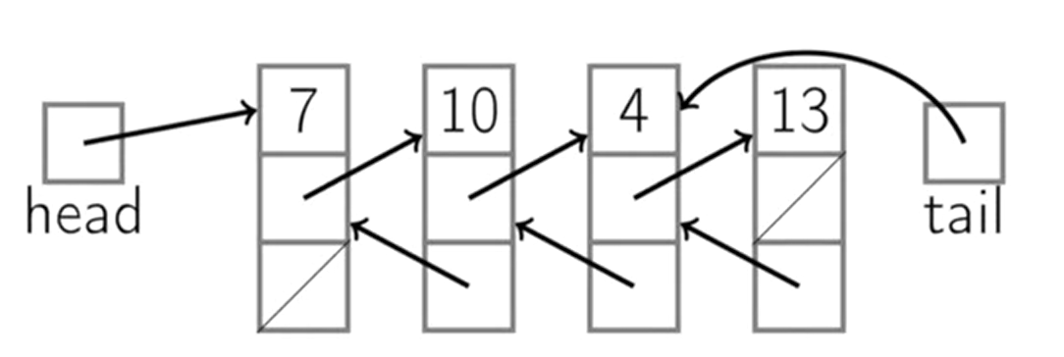
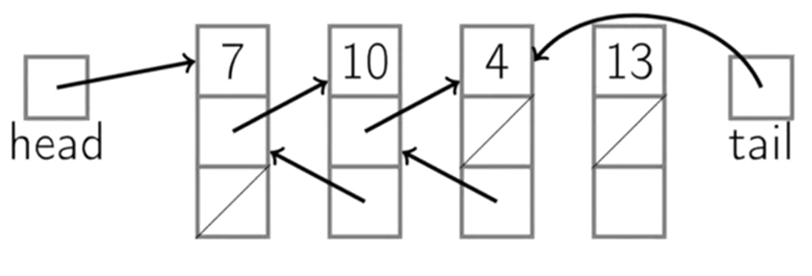
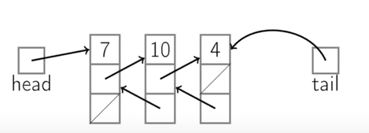
PopBack()
Time complexity O(1)

Slide 42
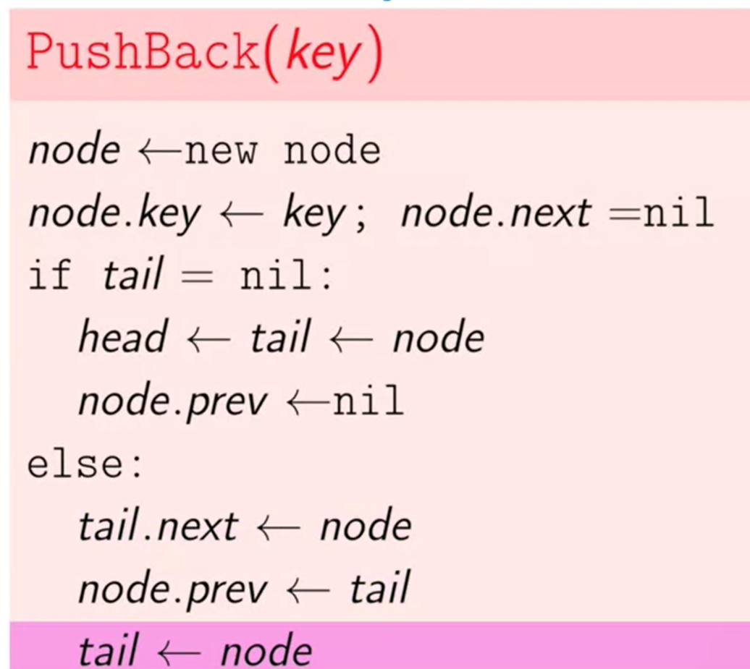

Slide 43
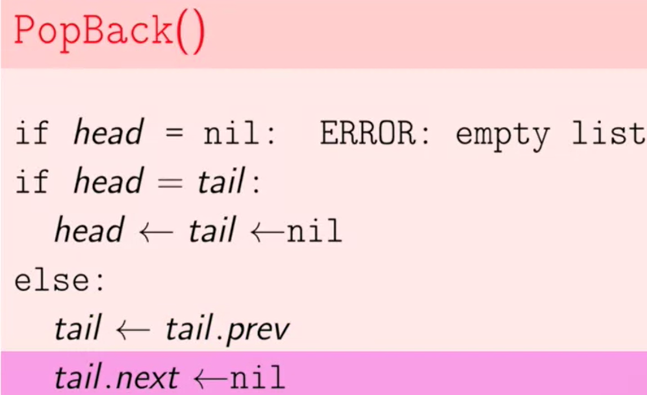
PopBack()

Slide 44
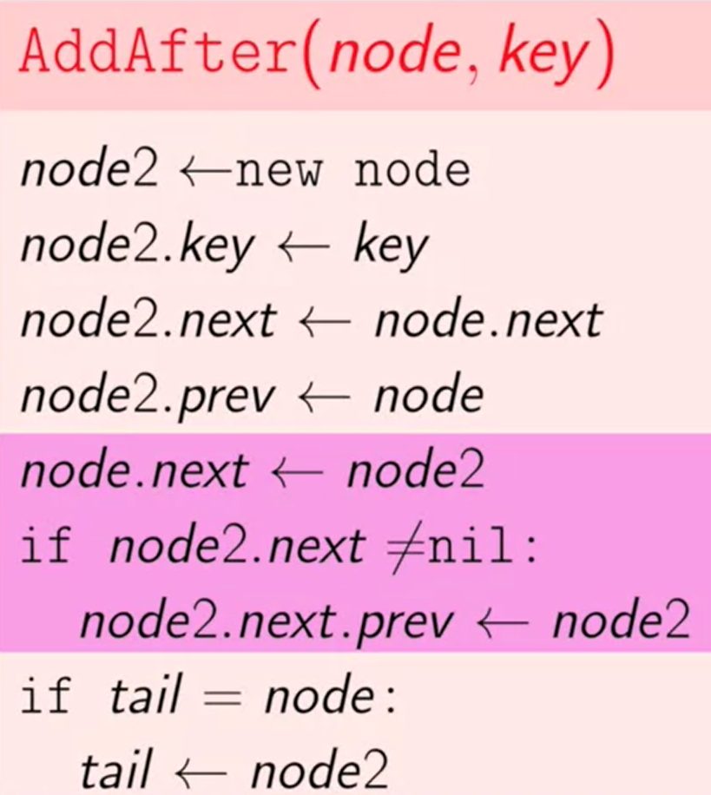

Slide 45
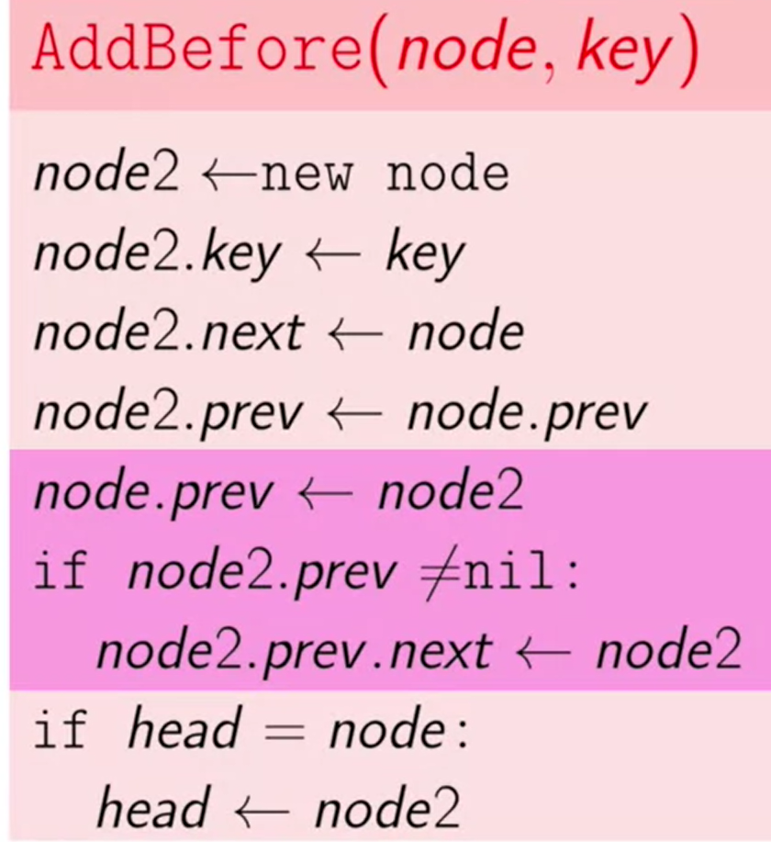

Slide 46


Slide 47
Summary
Constant time to insert at front or remove from the front.
With tail and doubly-linked, constant time to insert at or remove from the end.
O(n) time to find arbitrary element.
List elements need not be contiguous.
With doubly-linked list, constant time to insert between nodes or remove a node.

Slide 48

Circular Linked List
Try implementing all the functions (we discussed in the previous slides) on a circular list.

Slide 49


Slide 50

Circular doubly linked list
Try implementing all the functions (we discussed in the previous slides) on a circular doubly linked list.

Slide 51

Linear Search
Time Complexity: O(n)

Slide 52
Linear Search code - Array
#include <iostream>
using namespace std;
int search(int array[], int n, int x)
{
// Going through array sequencially
for (int i = 0; i < n; i++)
if (array[i] == x)
return i;
return -1;
}
int main()
{
int array[] = { 12, 114, 0, 4, 9 };
int x = 4;
int n = sizeof(array) / sizeof(array[0]);
int result = search(array, n, x);
(result == -1)
? cout << "Element not found"
: cout << "Element found at index: " << result;
}

Slide 53
Linear Search Code - Linked List
// Iterative C++ program to search
#include <iostream>
using namespace std;
class Node {
public:
int data;
Node* next;
Node(int new_data){
data = new_data;
next = nullptr; } };
// Checks whether key is present in linked list
bool searchKey(Node* head, int key) {
Node* curr = head;
while (curr != NULL) {
if (curr->data == key)
return true;
curr = curr->next;}
return false;}
int main() {
// Create a hard-coded linked list:
// 14 -> 21 -> 13 -> 30 -> 10
Node* head = new Node(14);
head->next = new Node(21);
head->next->next = new Node(13);
head->next->next->next = new Node(30);
head->next->next->next->next = new Node(10);
int key = 14;
if (searchKey(head, key))
cout << "Yes";
else
cout << "No";
return 0;}

Slide 54
// Recursive C++ program to search
#include <iostream>
using namespace std;
struct Node {
int data;
Node* next;
Node(int new_data) {
data = new_data;
next = nullptr;}};
// Checks whether the key is present in linked list
bool searchKey(struct Node* head, int key) {
// Base case
if (head == NULL)
return false;
// If key is present in current node, return true
if (head->data == key)
return true;
// Recur for remaining list
return searchKey(head->next, key);
}
int main() {
// Create a hard-coded linked list:
// 14 -> 21 -> 13 -> 30 -> 10
struct Node* head = new Node(14);
head->next = new Node(21);
head->next->next = new Node(13);
head->next->next->next = new Node(30);
head->next->next->next->next = new Node(10);
// Key to search in the linked list
int key = 14;
if (searchKey(head, key))
printf("Yes");
else
printf("No");
return 0;
}

Slide 55

Binary Search
Binary Search is a divide and conquer algorithm, so we have to divide the list in half and keep doing until we find our required element.
Time Complexity: O(log n)

Slide 56

Binary Search Code - Array

Slide 57
Binary Search Code - Array
On the next slide

Slide 58
#include <iostream>
using namespace std;
// Binary search for raw array
int binarySearch(const int arr[], int x, int low, int high) {
while (low <= high) {
int mid = low + (high - low) / 2;
if (arr[mid] == x)
return mid;
else if (arr[mid] < x)
low = mid + 1;
else
high = mid - 1;
}
return -1;
}
int main() {
// Initialize raw array
int arr[] = {2, 4, 5, 7, 14, 17, 19, 22};
int x = 22;
// Perform binary search
int result = binarySearch(arr, x, 0, sizeof(arr) / sizeof(arr[0]) - 1);
// Print result
if (result != -1)
cout << "Index: " << result << endl;
else
cout << "Not found" << endl;
return 0;
}

Slide 59
Binary Search - Linked List
Dry Run:
To find the middle node of the linked list
We will use two pointers approach in order to find middle of the linked list. The two pointers will be slow and fast, slow will jump a step( slow=slow→next) whereas fast will jump 2 steps( (fast = fast→next→next). So, when fast reaches end, slow reaches middle.

Slide 60





Slide 61



Slide 62


fast!=last (false) so we will return slow as middle node middle==key (element found)

Slide 63
Binary Search - Linked List
Code:
I will attached the complete code cpp file on GCR along with the this slide lecture.
You can check the snapshots of the function code on next slide

Slide 64


Slide 65


Slide 66
Interpolation Search
Interpolation search is an improvement over binary search.
Binary Search always checks the value at middle index. But, interpolation search may check at different locations based on the value of element being searched.
For interpolation search to work efficiently the array elements/data should be sorted and uniformly distributed.

Slide 67


Slide 68

Example if we are looking for element 4 in the given array

Slide 69
Code Example
I will attached the complete code cpp file on GCR along with the this slide lecture.

Slide 70
ToDo - Your turn to write code!!
Try all three search techniques on singly doubly, circular, and circular doubly linked list.

Slide 71
Reference
https://www.cs.emory.edu/~cheung/Courses/170/Syllabus/09/copy-array.html

Slide 72

All you need to have to achieve a dream/goal/task!!

Slide 73

Three promises you have to make to yourself!

Slide 74
Watch full video!!
https://www.youtube.com/watch?v=uxoCnxlxpIk

